Slide 1
IEEE Central Texas Section 2019 SPRING Planning Meeting January 19, 2019 San Marcus, TX
Section Committee/Officer Name: TEMS/Ryan Lamm
Chapter/Affinity Name: TEMS
Prepared by: Ryan Lamm

Slide 2
Mission and Leadership Team
Mission/2019 Focused Initiatives*
Increase awareness and participation in the San Antonio Area.
Explore small group approach (multiple smaller meetings) similar to TEMS Austin.
Late Winter/Spring 2019 Seminars
24 Jan (tentative): Organizational/management response to evolving cyber threats
Feb (tentative): 2019 leadership planning meeting
Fall 2019 Seminar
TBD
Leadership Team
Position Name Email
Chair Ryan Lamm rlamm@swri.org
Vice Chair Woodie Spivey woodie.spivey@utsa.edu
Treasurer Scott Atkinson s.Atkinson@ieee.org
Secretary Nils Smith nsmith@swri.org
Webmaster/vtools
Program
Member at large
(*) These can be technical meetings, workshops, networking events, etc.

Slide 3
2019 Key Accomplishments
Meetings (month, topic, L31):
Jan 24, 2019 (tentative): Organizational/management response to evolving cyber threats
Other Activities/Events:
2018 and 2019 activities and budgets reviewed and submitted to CTS.

Slide 4
2019 Chapter Vitality & Help Needed
Chapter Vitality Assessment (Strong, Ok, Need Improvement)
Need Improvement
Attendance: light and limited mostly to SwRI employees.
Membership Recruitment: Need access to broader distribution list for seminars/sessions.
Top Help Needed/Issues
Membership Recruitment
Collaboration with Business Schools with emphasis in technology
Meeting Venues other than SwRI.

Slide 5
Others/Backup
Xxxxx
xxxx

Slide 6
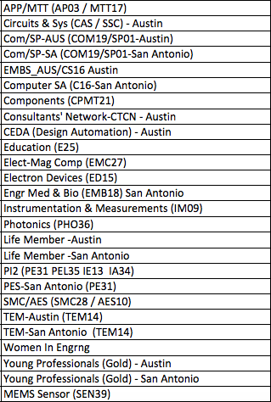
CTS Leadership
CTS Officers
Chapters/Affinity
Standing Committees/Coordinators
Chair
Fawzi Behmann
Vice Chair – A
Fabio Gomez
Vice Chair – SA
Ehsaneh Sunny Shahhaidar
Secretary
Raymond Choo
Treasurer
Bill Martino
Past Chair
Leslie Martinich
Past Past Chairs
Kenny Rice
Strategic Plan
Policies and Procedures PARP
Awards and Recognition
Membership Development
Electronics Communications
Website
vTools
Communications Portal
Conferences/Events
Section-Chapter Vitality Chair
Finance
K-12/STEM Educational Activities
Students Activities
Professional Activities – PACE
Outreach Program
Humanitarian

